Slide 1
New York Times Headlines
Last Quarter’s Growth Is Revised Down Sharply—9.28.2012
U.S. Growth Revised Up, but Year-End Slowdown Is Feared—11.30.2012
U.S. Economy Expanded Slightly in 4th Quarter—3.1.2013
Economy Grows Despite Tax Rise and Spending Cuts—3.29.2013
Federal Cuts Are Concern in Modest U.S. Growth—4.27.2013

Slide 2
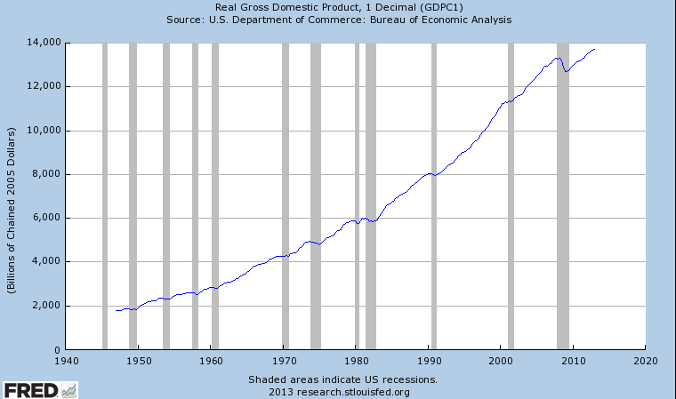
Real GDP in the United States
Since 1940

Slide 3
Which Country Is Better Off?
 | Country A | Country B | Country C
GDP | $1,500 | $2,500 | $3,000

Slide 4
Which Country Has the Highest Standard of Living?
 | Country A | Country B | Country C
GDP | $1,500 | $2,500 | $3,000
Population | 5 | 10 | 15

Slide 5
GDP per Capita
 | Country A | Country B | Country C
GDP | $1,500 | $2,500 | $3,000
Population | 5 | 10 | 15
GDP/capita | $300 | $250 | $200

Slide 6
GDP per Capita, 2012 (current U.S. Dollars)
Country | GDP/Capita
United States | $51,749
Mexico | $9,749
China | $6,091
India | $1,489
Russian Federation | $14,037
Zimbabwe | $714
Spain | $28,624
Germany | $41,863
Greece | $22,083

Slide 7
Factors Contributing to Long-Term Economic Growth
Technological innovation
High investment in human capital and capital goods

Slide 8
Factors Contributing to Long-Term Economic Growth
Technological innovation
High investment in human capital and capital goods
High level of economic freedom
Strong incentives to save and invest
Political stability
Free trade
Slower rates of population growth
Low inflation

